Slide 1
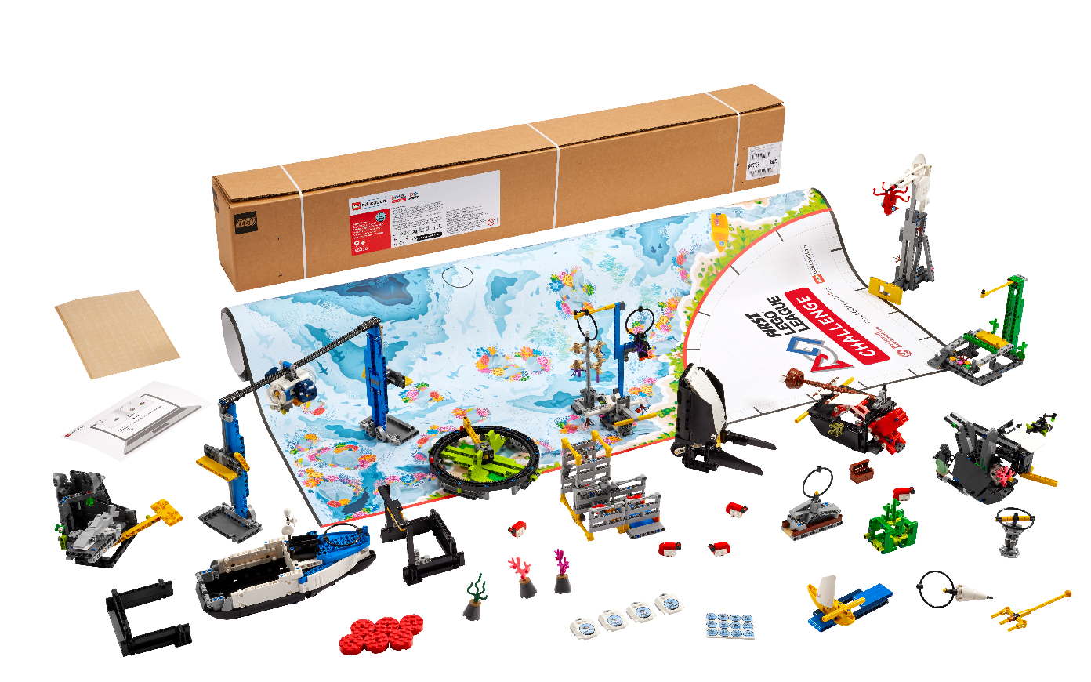


Session 3
Training Camp 2
Notes:
Facilitator Tips - As the team completes the sessions, ask them to collect evidence of their use of the Core Values.
What does each Core Value look like?
What does it sound like when people are using the Core Values appropriately?
How do people communicate with each other when they have a disagreement?
Session 3 Tips =
This activity is a great way for the team to collaborate creatively on a piece that represents their shared interests.
Team planning and project management is important to achieve goals and be ready for the tournament.
Have the team check that the wires are plugged into the right ports and that the ports used match their program.
To make missions easier to complete, the team can build LEGO® attachments and fit them onto the robot.
Robot Game Connection: Have the team think about how to use the attachment from the robot lesson to complete missions.

Slide 2
Session Overview
Outcomes
Explore and research ideas for their innovation project.
Code their robot to avoid obstacles using a sensor and to power an attachment.
Notes:
Session Outcomes
Explore and research ideas for their innovation project.
Code their robot to avoid obstacles using a sensor and to power an attachment.
Facilitator Tips - As the team completes the sessions, ask them to collect evidence of their use of the Core Values.
Session 3 Tips
If your team has already agreed on the focus of their project, encourage them to begin researching the topic. You can find helpful resources on the season resource page.
Team planning and project management is important to achieve goals and be ready for the tournament.
Encourage the team use their Engineering Notebooks and to take notes when researching their ideas.
Have the team check that the wires are plugged into the right ports and that the ports used match their program.
Robot Game Connection: Have the team think about how to use the attachment from the robot lesson to complete missions.

Slide 3
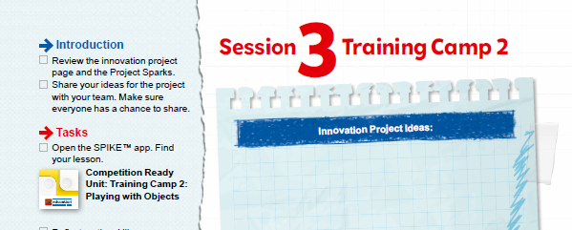
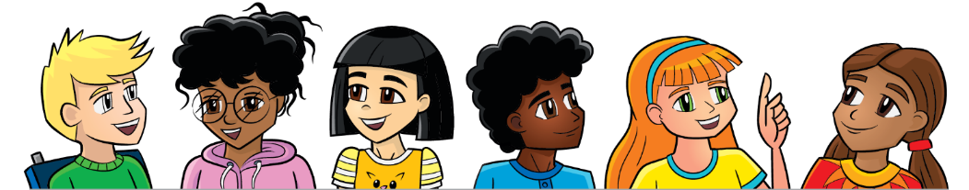
Introduction
Review the innovation project page and the Project Sparks.
Share your ideas for the project with your team. Make sure everyone has a chance to share.
Notes:
Session Outcomes
Explore and research ideas for their innovation project.
Code their robot to avoid obstacles using a sensor and to power an attachment.
Facilitator Tips - As the team completes the sessions, ask them to collect evidence of their use of the Core Values.
Session 3 Tips
If your team has already agreed on the focus of their project, encourage them to begin researching the topic. You can find helpful resources on the season resource page.
Team planning and project management is important to achieve goals and be ready for the tournament.
Encourage the team use their Engineering Notebooks and to take notes when researching their ideas.
Have the team check that the wires are plugged into the right ports and that the ports used match their program.
Robot Game Connection: Have the team think about how to use the attachment from the robot lesson to complete missions.

Slide 4
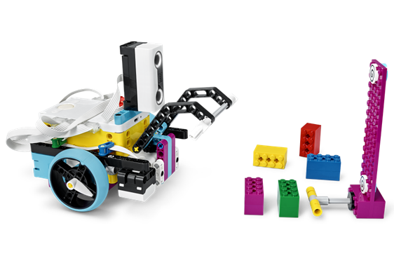
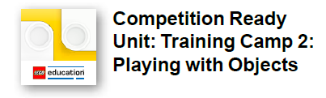
Training Camp 2
Open the SPIKE™ Prime app. Find your lesson.
Reflect on the skills you learned that will be beneficial in completing missions.
Try it out! See if you can code your robot to complete a mission.
Notes:
Team Tasks (100-120 minutes) - Training Camp 2: Playing with Objects – https://education.lego.com/en-us/lessons/prime-competition-ready/training-camp-2-playing-with-objects#lesson-plan
URL for SPIKE on-line: https://spike.legoeducation.com (remember to use a Chrome browser)
Session Outcomes
Explore and research ideas for their innovation project.
Code their robot to avoid obstacles using a sensor and to power an attachment.
Facilitator Tips - As the team completes the sessions, ask them to collect evidence of their use of the Core Values.
Session 3 Tips
If your team has already agreed on the focus of their project, encourage them to begin researching the topic. You can find helpful resources on the season resource page.
Team planning and project management is important to achieve goals and be ready for the tournament.
Encourage the team use their Engineering Notebooks and to take notes when researching their ideas.
Have the team check that the wires are plugged into the right ports and that the ports used match their program.
Robot Game Connection: Have the team think about how to use the attachment from the robot lesson to complete missions.

Slide 5
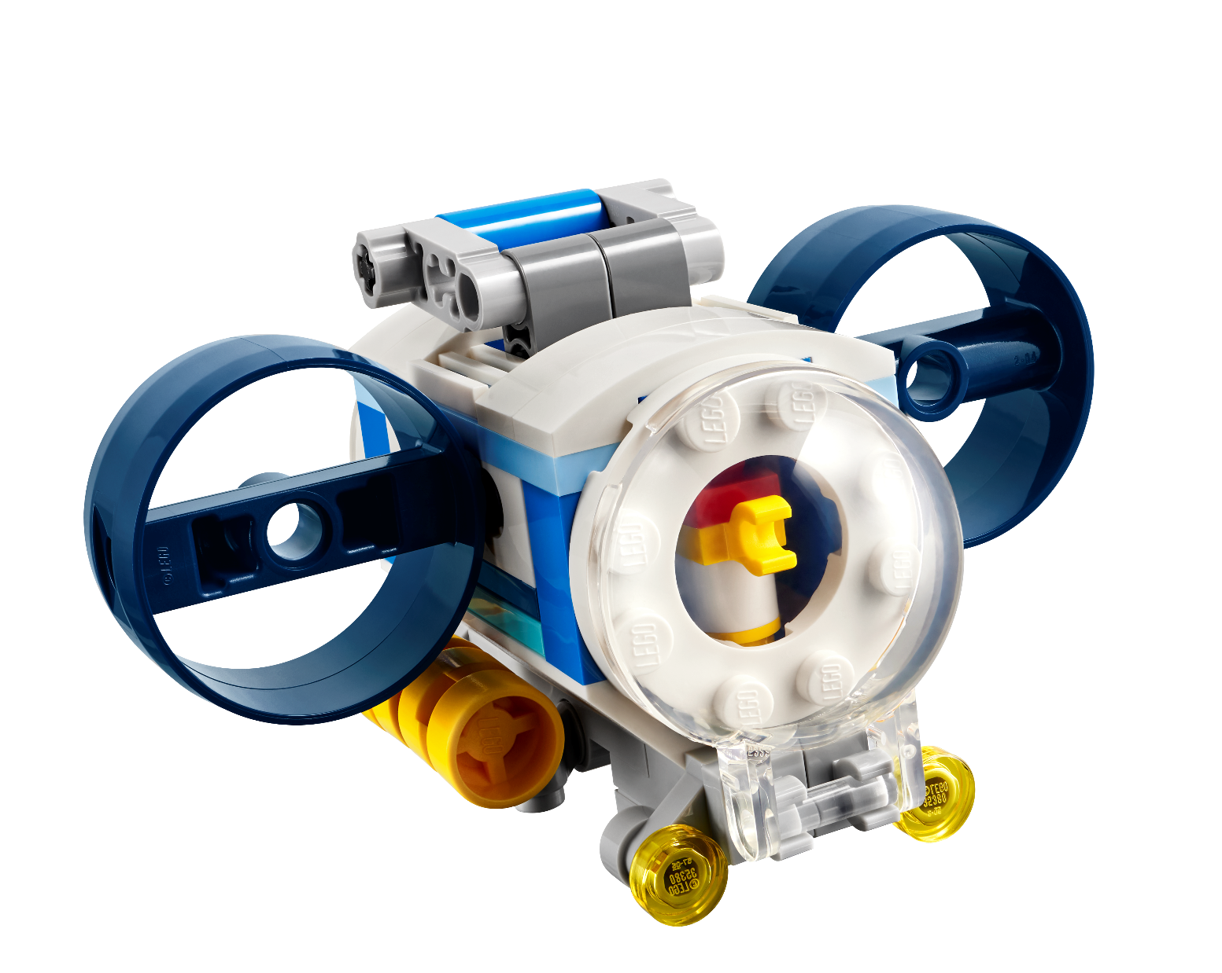
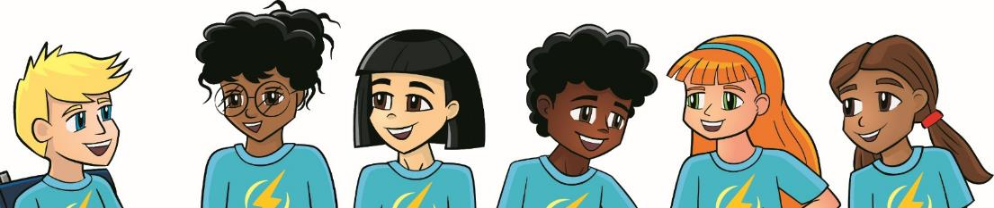
Share
Get together at the mat.
Share the robot skills you learned.
Chat about the reflection questions.
Clean up your space.
Notes:
Share (10-15 minutes)
Session Outcomes
Explore and research ideas for their innovation project.
Code their robot to avoid obstacles using a sensor and to power an attachment.
Facilitator Tips - As the team completes the sessions, ask them to collect evidence of their use of the Core Values.
Session 3 Tips
If your team has already agreed on the focus of their project, encourage them to begin researching the topic. You can find helpful resources on the season resource page.
Team planning and project management is important to achieve goals and be ready for the tournament.
Encourage the team use their Engineering Notebooks and to take notes when researching their ideas.
Have the team check that the wires are plugged into the right ports and that the ports used match their program.
Robot Game Connection: Have the team think about how to use the attachment from the robot lesson to complete missions.

Slide 6
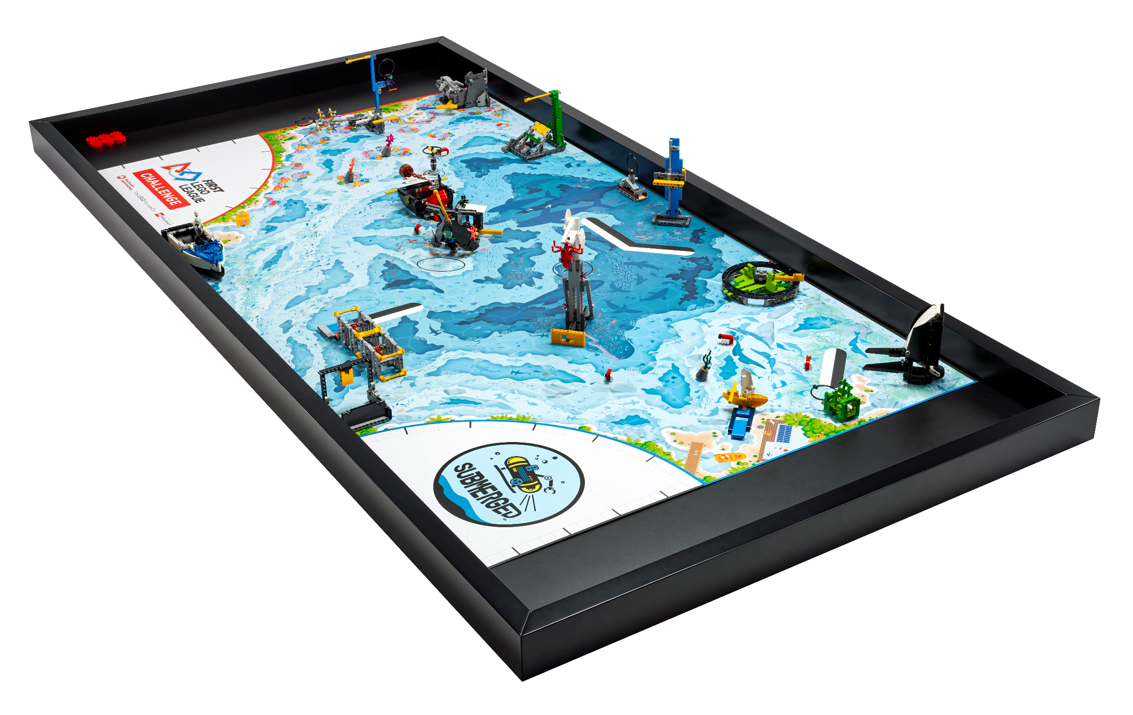
Reflection Questions
What research can you do to explore the ideas for your innovation project?
What objects does your robot need to avoid?

Slide 7
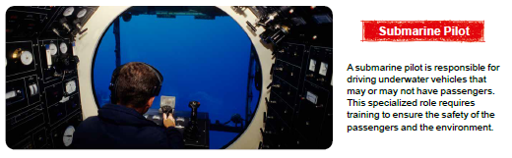
Career Connections

Slide 8

Multimedia Resources
You may wish to embed a relevant, age-appropriate video for your students here.
Notes:
Choose a relevant, age-appropriate video for your students.

Slide 9
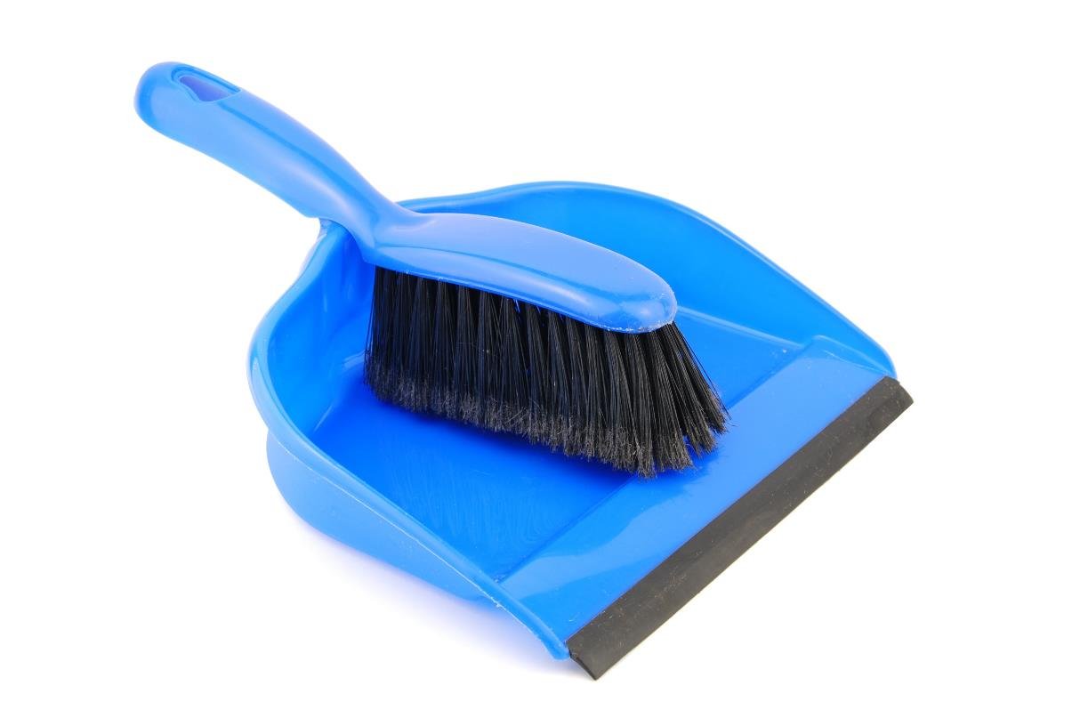
Clean Up
Notes:
Allow time for cleanup and place any unfinished models and their pieces in a sealed plastic bag.
Clean Up Pointers
You may wish to play a video or song during clean up time Link on
GoNoodle: https://family.gonoodle.com/activities/clean-up
Link on YouTube Kids: https://www.youtubekids.com/watch?v=ZJFk87ZsHn0
Link on Youtube: https://youtu.be/ZJFk87ZsHn0

Slide 10


LEGO, the LEGO logo, the SPIKE logo, MINDSTORMS and the MINDSTORMS logo are trademarks of the/sont des marques de commerce du/son marcas registradas de LEGO Group. ©2024 The LEGO Group. All rights reserved/Tous droits réservés/Todos los derechos reservados. FIRST ®, the FIRST ® logo, Coopertition ®, Gracious Professionalism®, and FIRST® DIVESM are trademarks of For Inspiration and Recognition of Science and Technology (FIRST). LEGO® is a registered trademark of the LEGO Group. FIRST® LEGO® League and SUBMERGEDSM are jointly held trademarks of FIRST and the LEGO Group. All other trademarks are the property of their respective owners. ©2024 FIRST and the LEGO Group. All rights reserved.

